Slide 1

Lending Club Case Study
By Ravi Theja and Bhushan Pande

Slide 2

Problem Statement
To identify patterns from data provided which indicate if a person who applied for loan is likely to default. Based on the patterns company can take decisions such as denying the loan, reducing the amount of loan, lending (to risky applicants) at a higher interest rate, etc.
In other words, the company wants to understand the driving factors (or driver variables) behind loan default, i.e. the variables which are strong indicators of default. The company can utilize this knowledge for its portfolio and risk assessment.

Slide 3
Steps for EDA
Data Cleaning
Deleting columns which are not required for analysis.
Deleting columns which have single value or constant value for all rows.
Dropping rows which have null values
Data Conversion – Converting column values to appropriate datatypes which can be used for analysis.
Derived columns - Create new columns to get additional insights
Univariate and Bivariate analysis
Correlation Analysis
Observations and Conclusion

Slide 4
Driver variables for loan default
Interest Rate
Annual Income
Loan Amount
Grade of the Loan
Purpose of the Loan
Public record for bankruptcies
Employment Length

Slide 5
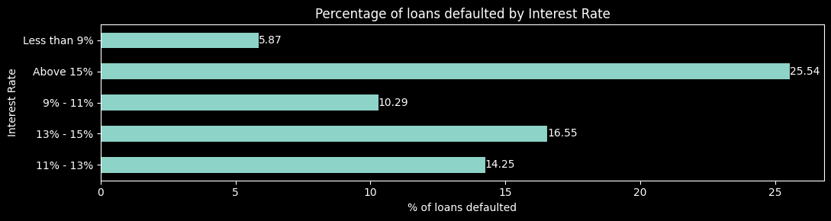
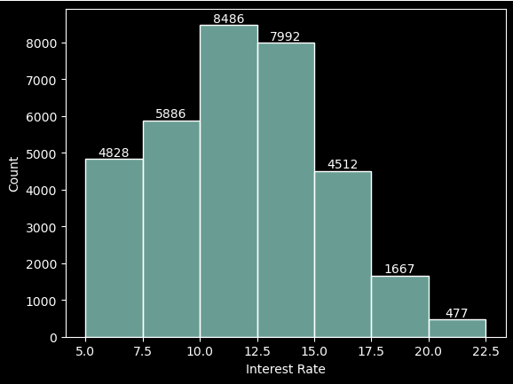
Interest Rate
Average loan interest rate is 11.82%.
Most approved loans have an interest rate between 10-12.5%.
Loans with interest rates less than 9% have relatively less chances of default.
Interest rates are starting from minimum 5.42 %.
Loans with interest rates above 15% have relatively higher chances of default.
The rate of loan defaults increases as the interest rate rises.

Slide 6
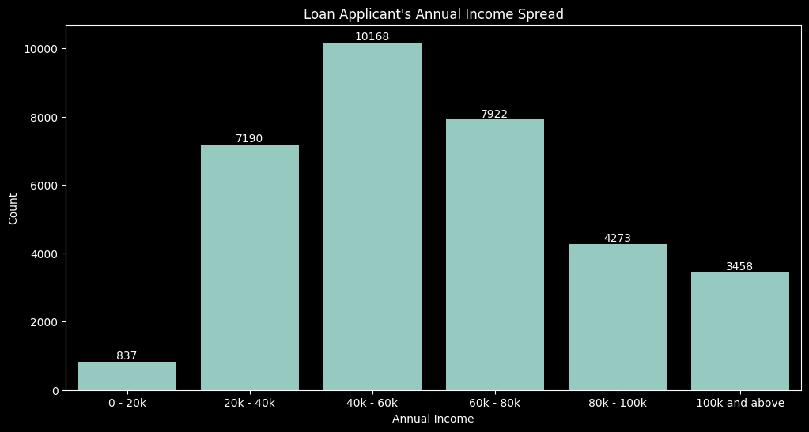
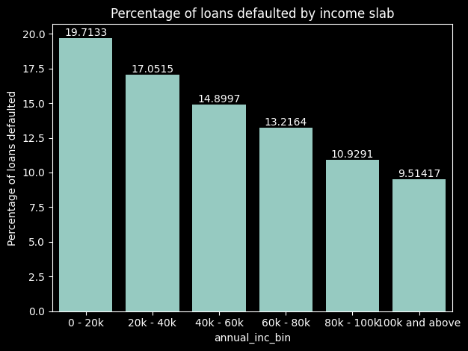
Annual Income
The median annual income is 55.5k.
Borrowers with an annual income of 40-60k apply for more loans than any other income bracket.
The rate of loan defaults decrease with increase in borrower’s annual salary.

Slide 7
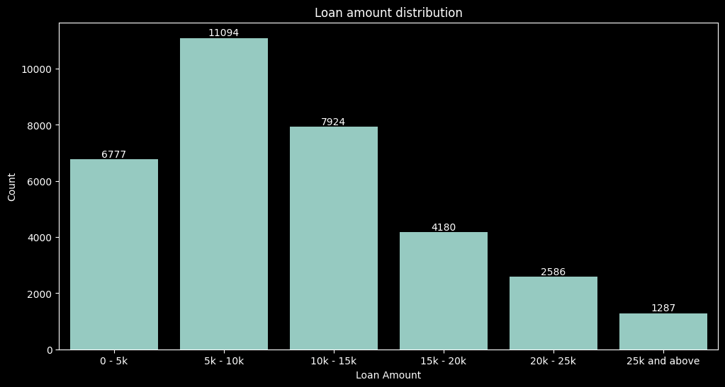
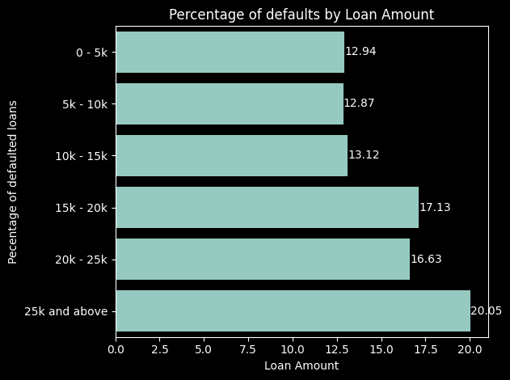
Loan Amount
Most loans fall within the 5k to 10k range, but these loans do not have the highest default rates, indicating that borrowers may be more capable of repaying smaller loans.
The highest rate of default is observed in the $25,000 and above category, with a default rate of 20.05%.
The default rate generally increases with the loan amount.

Slide 8
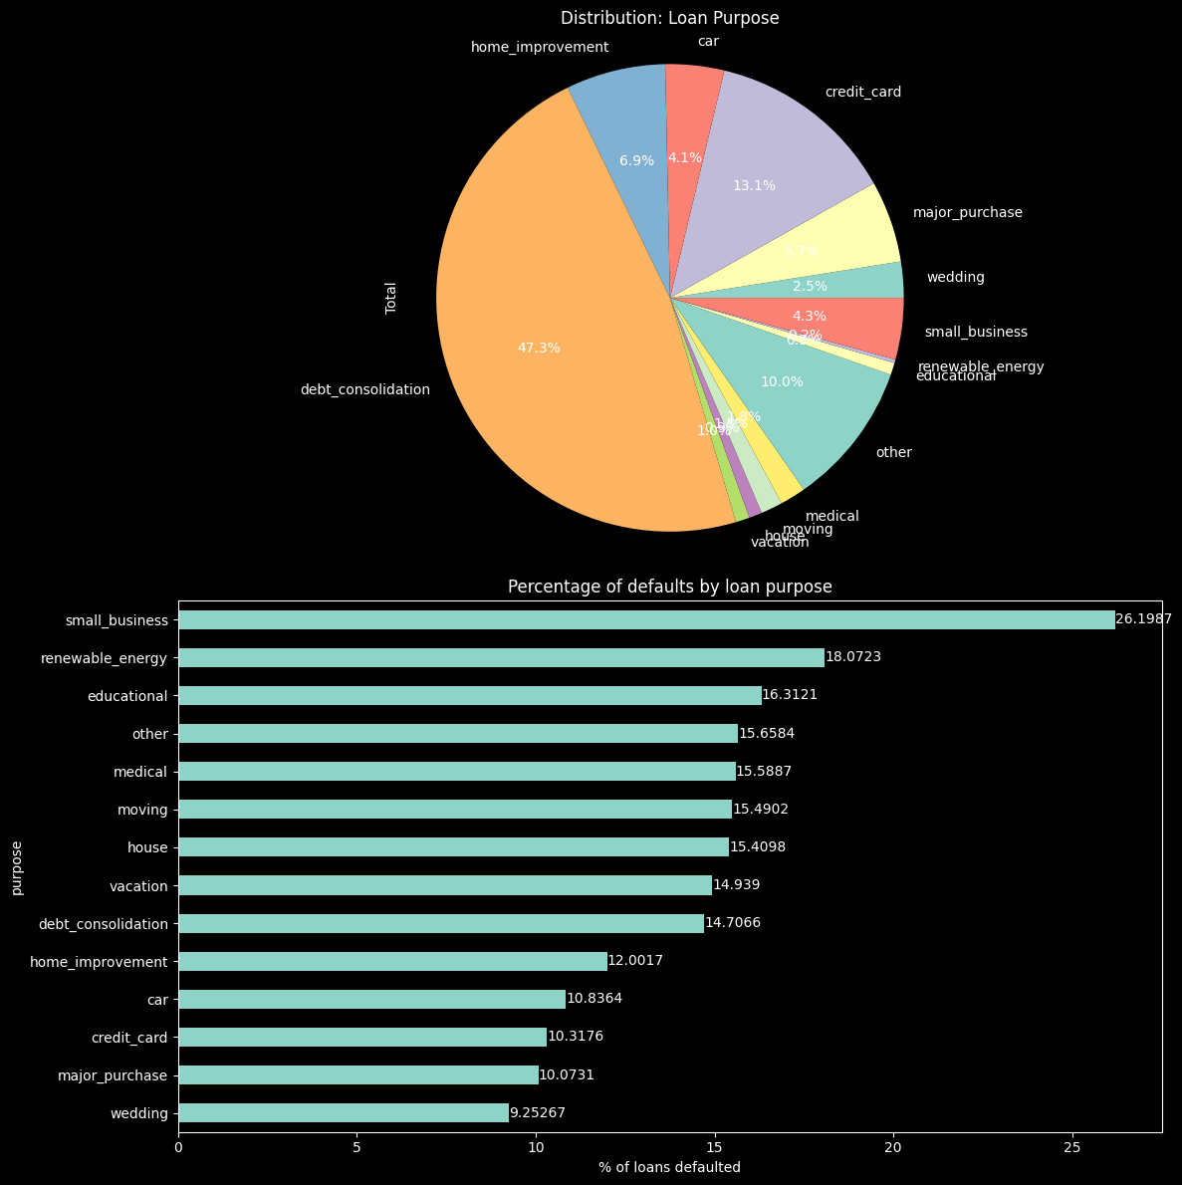
Purpose of loan
Debt Consolidation is the most popular purpose (47.3% of total loans).
Small business loans and renewable energy loans are the riskiest loans with 26.19% and 18% default rate respectively.

Slide 9
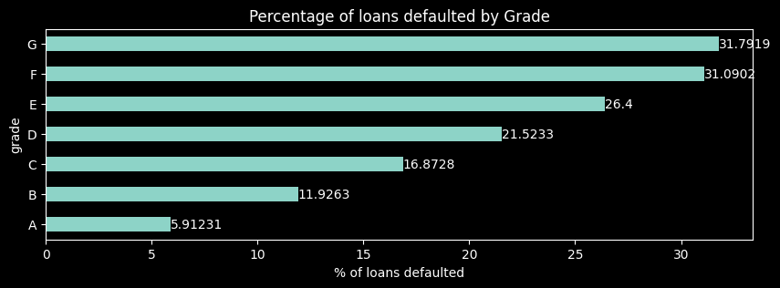
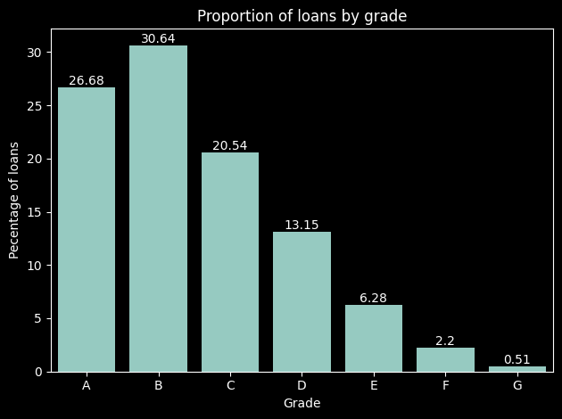
Loan Grade
Lower grades have the highest rates of default despite having lower proportions.
Lower grades have significantly higher default rates compared to higher grades.
There is an inverse correlation between loan grade and rate of default. The lower the grade, higher the chances of default.

Slide 10
Public record for bankruptcies.
Observations:
Interest rate less than 9% has very less chances of default. Interest rates are starting from minimum 5 %.
Most applicants have defaulted on loans where the interest rate was more than 15%.
Loan default proportion increases with higher interest rates.

Slide 11
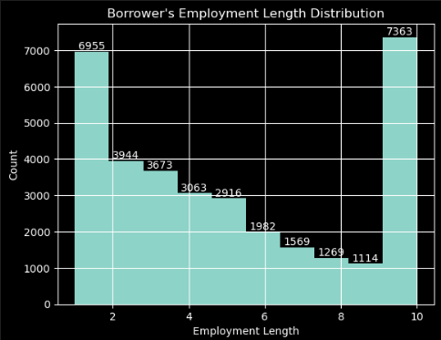
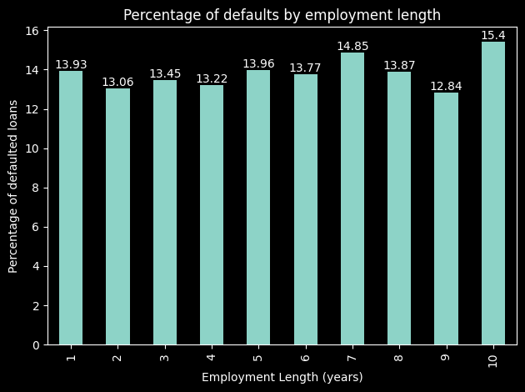
Employment Length
Observations:
Contrary to popular belief, longer employment doesn’t necessarily lead to lower default rates as it can be seen that the default rate increases for borrowers who 10+ years of employment length.

Slide 12

Patterns resulting in loan defaults.
Observations:
* Interest rate less than 9% has very less chances of charged off. Interest rates are starting from minimun 5 %.
* Interest rate more than 16% has good chance of charged off as compared to other category interest rates.
* Charged off proportion is increasing with higher interest rates.

Slide 13
Thank you

